Slide 1
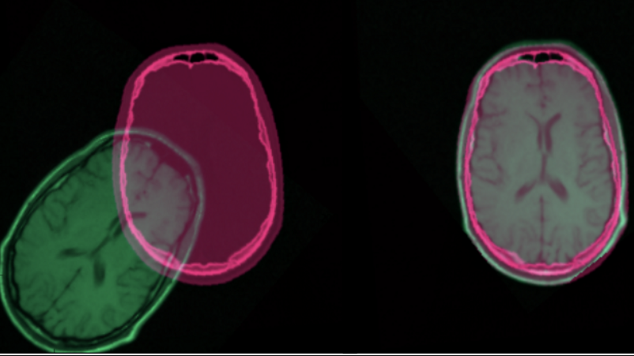
Deep Learning for Image Registration
Evyatar Michlis & Amitai Ovadia

Slide 2
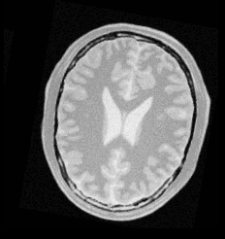
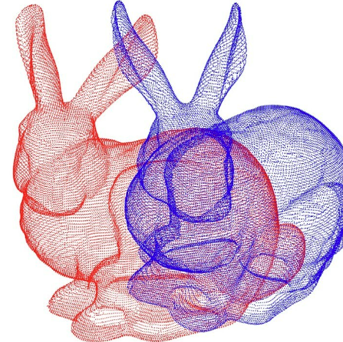
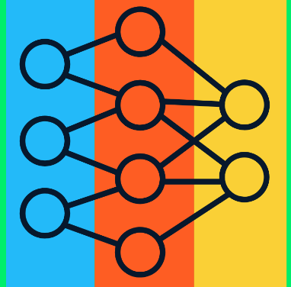
Agenda
Registration Overview
Affine registration background
Article 1 – affine medical image registration
Deformable registration background
Article 2 – deformable medical image registration
Summary

Slide 3

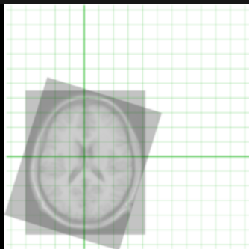
Registration
“The process of establishing a common geometric reference frame between two or more data sets from different modalities”

Slide 4
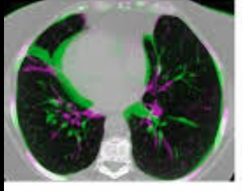
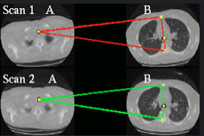
Motivation
Fusion of data from several sources
Track relative position of instruments and anatomy during surgery
Compare “before” and “during” surgical information
Following growth rate of a tumor

Slide 5
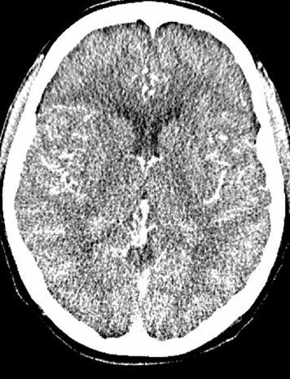
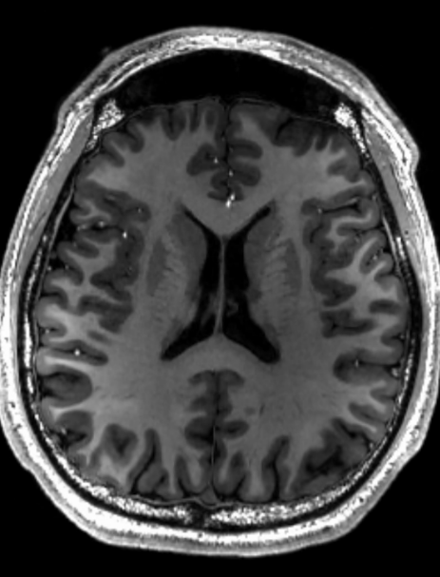
Types Of Registration
Monomodal: CT, MR, PET, Xray, MRI
Multimodal: CT/MRI, CT/NMR, MRI/NMR
Image to model: Model is a segmentation or a parametric atlas

Slide 6
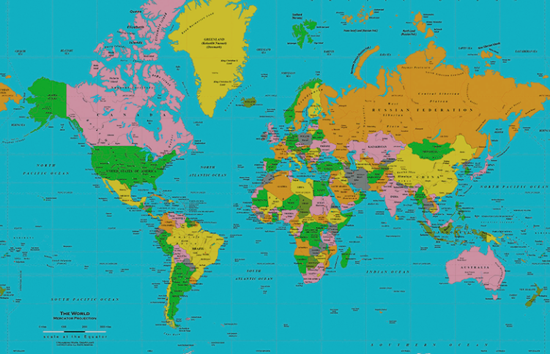
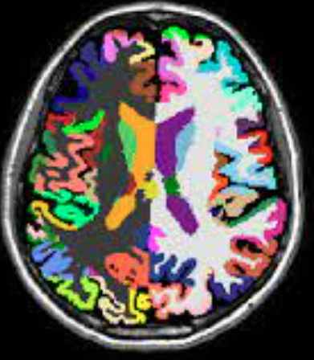
Parametric Atlas
Tool for measuring registrations
Can be some agreed upon reference or average volume of some dataset

Slide 7
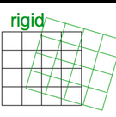
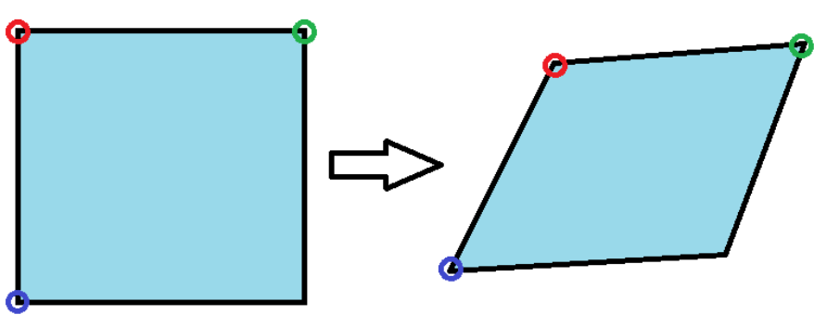
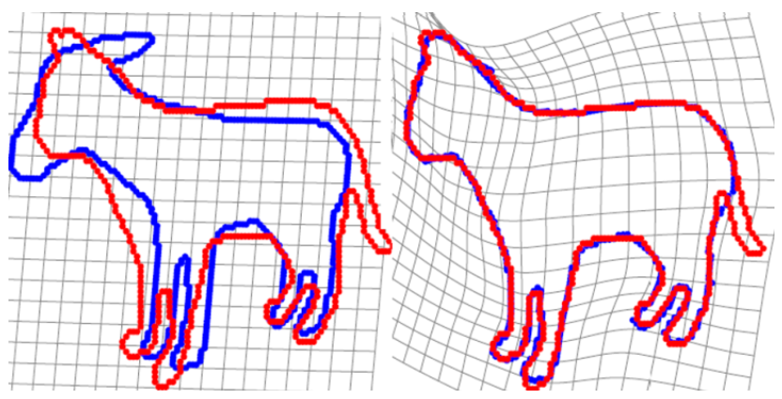
Different Registration Tasks
affine
Rigid
Affine
Deformable
deformable

Slide 8
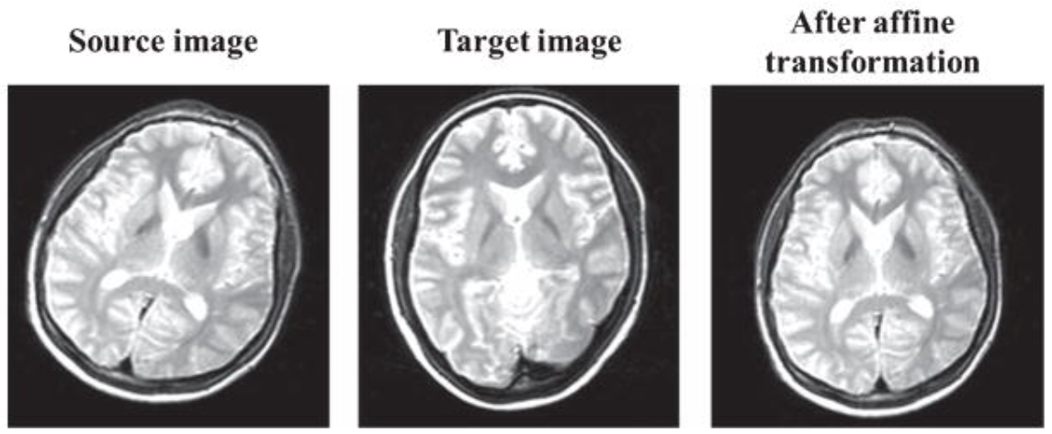
Affine Registration
Alline scans without soft tissues (bones)
Pre-alignment before deformable registration (crucial)

Slide 9
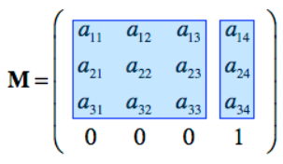
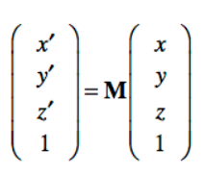
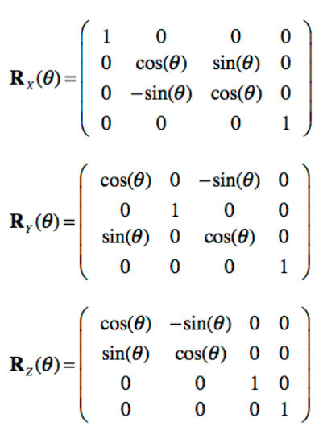
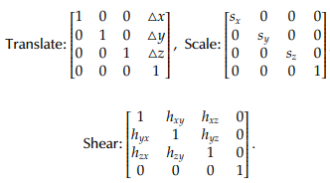
Affine Transformation Matrix
Any combination of translation, rotation, scaling and shear

Slide 10
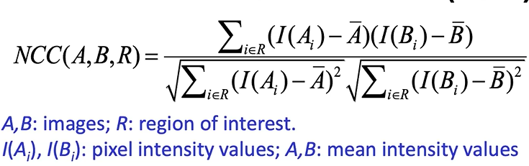
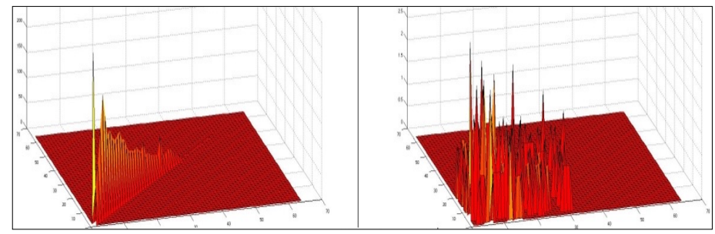
Conventional Affine Registration Methods
Minimizing objective function using gradient descent
NCC (Normalized cross correlation)
Entropy of Joint Histogram
Coarse to fine:
C2F techniques
C2F Image pyramids
Overall, conventional approaches excel in registration performance!

Slide 11
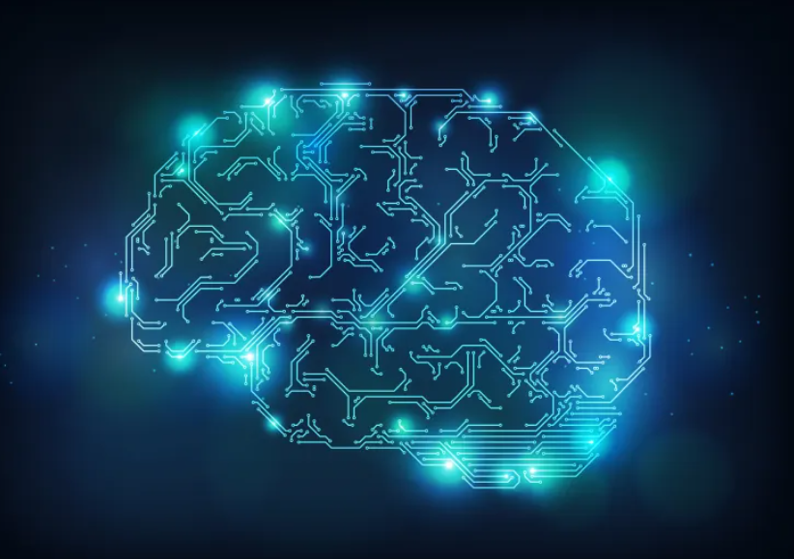
So Why Use Deep Learning?
Conventional methods are slow
Searching in high dimensional space
Determine gradient direction:
Evaluating the objective function many times for each iteration
Runtime is not always deterministic
Can depend on the initial misalignment
Perhaps deep learning can do even better?

Slide 12
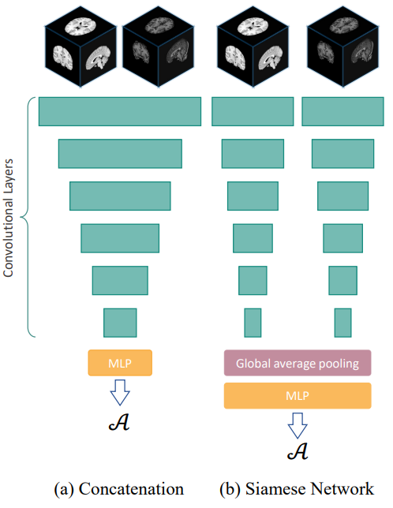
Current Deep Learning Methods For Affine Registration
Most methods learn joint affine and deformable registration with CNNs
Subnetwork A for the affine part
Subnetwork B for the deformable part
Existing CNN-based approaches can be divided into two categories:
Concatenation based
Siamese network
Don’t perform so well:
Can’t handle bit initial misalignment (concatenation based)
Good only for the global alignment, ignore fine details (Siamese network)

Slide 13
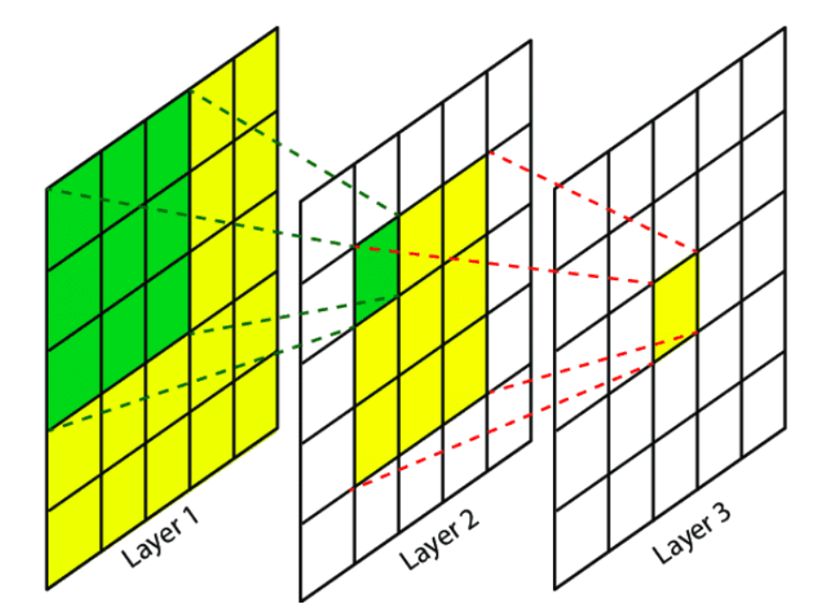
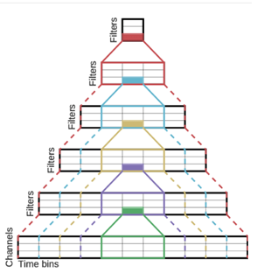
Is CNN the Optimal method?
Not according to the article!
They claim:
CNNs are not optimal for affine registration!
CNNs rely on local correlations inside an image (pixels' neighbourhood)
Global correlations are bounded by the CNN receptive field
Affine registration is global
The misalignment parameters are global features
A global task requires a global perspective!

Slide 14

Transformers To The Rescue!

Slide 15
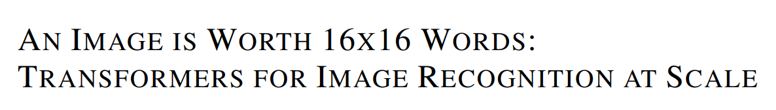
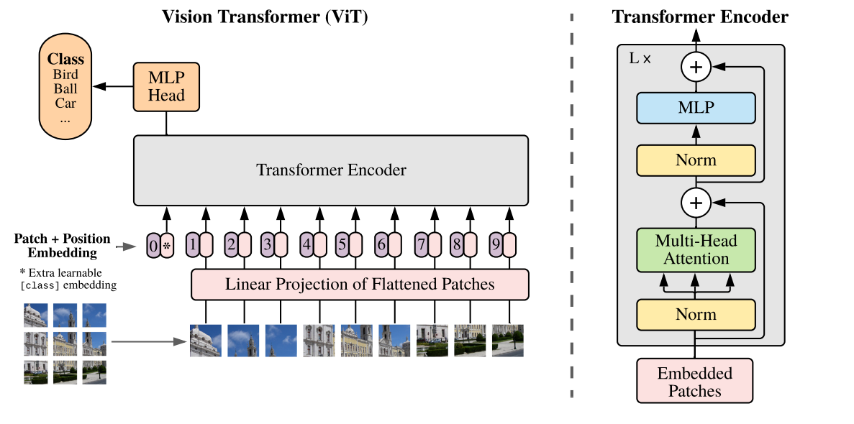
Before the article brief Intro to Vision transformers
Brought from the field of NLP
Recently proved state of the art performance (compared to CNNS)
General pipeline:
Image is divided to patches (with/without overlap) (like words in NLP)
Each patch is flattened into a vector
The patches are projected via a linear layer
A position embedding is attached to each patch
Going through a transformer encoder
MLP head (a feedforward layer)

Slide 16
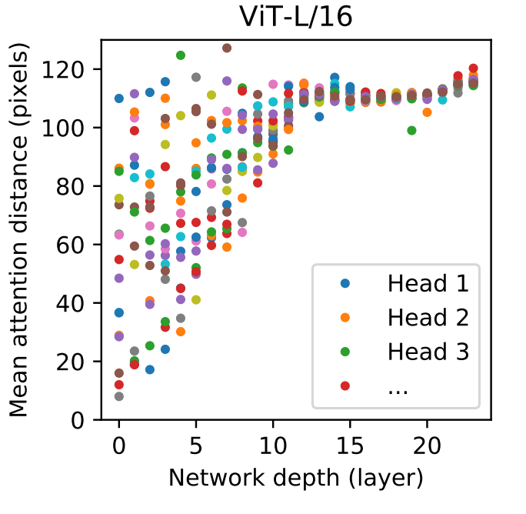
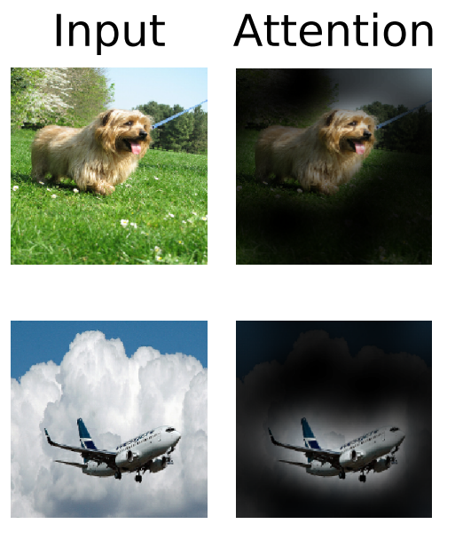
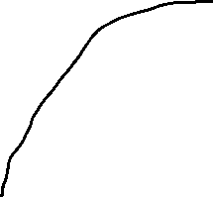
Attention
The defining feature of transformers
What parts of the image/features should the network focus on?
Function that for every pair of image patches returns a correlation score
Long distance correlations are identified already at the first layers!
Unlike CNNs (due to receptive field)
Starting to smell like what we need for affine registration ☺
CNNS

Slide 17
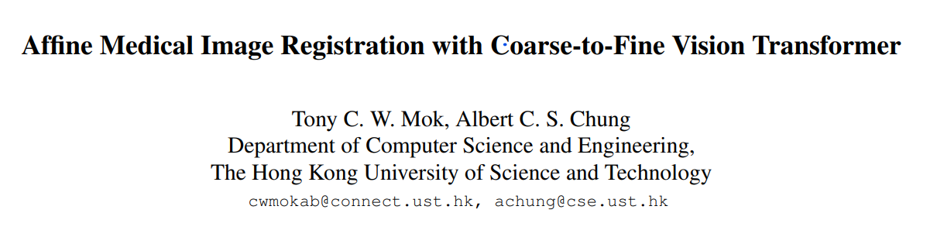
Presents a novel learning based affine registration algorithm - C2FViT for 3D medical affine registration
A transformer-based method
Operates in a course to fine manner
Outperforms the recent CNN-based affine registration approaches

Slide 18
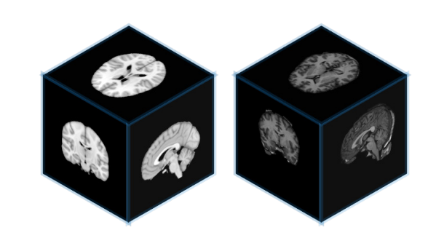
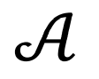

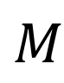
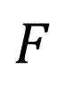
Method Overview
$$F$$
$$M$$
Input $F,M$ (fixed and moving 3D images)
Output $A$ the affine transformation matrix to align $F,M$

Slide 19
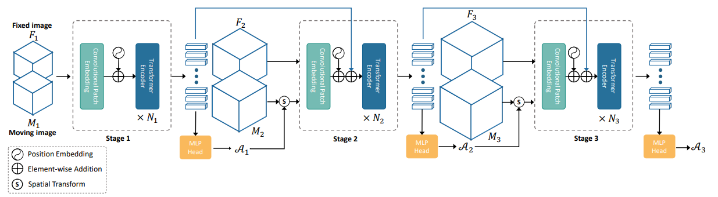













Method Overview
Construct 3-level image pyramid - down sampling $F,M$ by a scale factor of 0.5
3 stages
$F_{i},M_{i}$ are the down sampled images of the stage $i$ (reverse order to size)
Example: $F_{1}$ = ${250}^{3},$ $F_{2}$ = ${500}^{3}$, original image $F_{3}$ = ${1000}^{3}$,
For each stage, we find the affine transformation matrix $A_{i}$ that aligns $F_{i},M_{i}$
Use $A_{i}$ for initially align $F_{i+1},M_{i+1}$

Slide 20

Main Idea
Big initial misalignments can be resolved efficiently in low resolution
For the more refined parts we use higher resolution
Transfer learning between stages

Slide 21






Method Overview
For each stage $i$:
Concatenate $F_{i},M_{i}$
Transformer encoder black box (explained later) outputs a feature vector
goes through an MLP head (feed-forward NN) with Tanh activation
MLP head outputs $A_{i}$ the affine transformation matrix
Next stage:
$M_{i+1}$ image is transformed by $A_{i}$ matrix for initial alignment
Feature vector injected to next stage patch embedding
Return final $A_{3}$ matrix

Slide 22
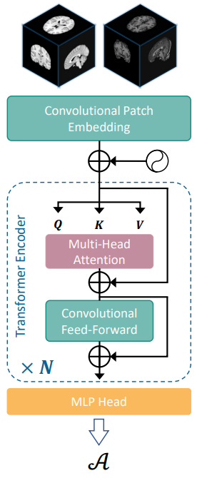








Stage $i$ $(part a)$
Concatenate $F_{i},M_{i}$
Convolutional patch embedding layer (unlike ViT)
3D convolution layer:
Divides input into $N$ (up to $4096$) patches (with overlap)
patches of size $d (256)$
Produce $\hat{Z}∈ℝ^{N×d}$

Slide 23












Stage $i$ $(part b)$
$N_{i}=4$transformer encoder blocks
For every head of the multi-head attention $j∈\{1,2\}$:
Define these linear embeddings of $\hat{Z}$ :
$Q_{j}=\hat{Z}W_{j}^{Q}, K_{j}=\hat{Z}W_{j}^{K}, V_{j}=\hat{Z}W_{j}^{V}$ $\left(W_{j}^{Q},W_{j}^{K},W_{j}^{V}∈ℝ^{d×d_{h}}\right), { d}_{h}=\frac{d}{h}, h=2$
Compute in parallel each attention head
$Attention\left(Q_{j},K_{j},V_{j}\right)=Softmax\left(\frac{Q_{j}K_{j}^{T}}{\sqrt{d_{h}}}\right)V_{j}$ (every row of $Q_{j}$, and column of $K_{j}^{T}$ are patches)
A patch-wise feed forward network with 2 hidden layers
Between layers: depth-wise convolution layer (to add locality)

Slide 24



Stage $i$ $(part c)$
After N Transformer encoder blocks:
MLP head (feed-forward NN) with Tanh activation
Output matrix $A_{i}$
Questions?

Slide 25
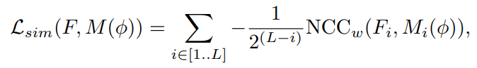
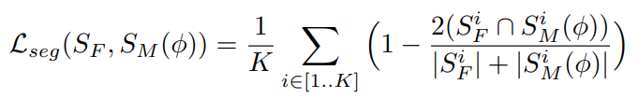
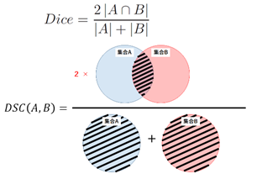
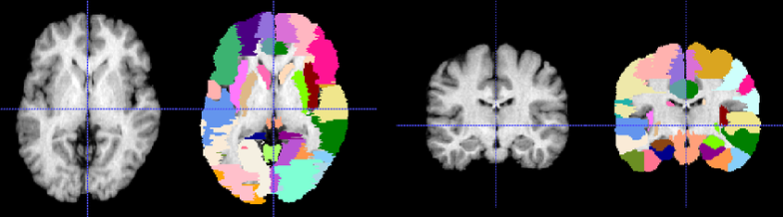



Loss functions (Training)
Unsupervised: Normalized cross correlation
Normalized pixelwise comparison between $F,M$
Sum over all stages, more weight on last stages
$L=$ the number of stages, $w=$window size
Semi-supervised: segmentations comparison $(1−Dice)$
If segmentation data is available in training set
$ℒ_{tot}=ℒ_{sim}+λℒ_{seg}$
$K=$ number of anatomical structures
$S_{F}^{i},S_{M}^{i}=$fixed\moving image segmentation of structure $i$
$$M$$
$$F$$

Slide 26
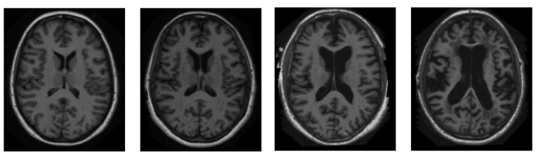

Experiments
OASIS dataset
The all the methods were evaluated on 2 tasks:
Brain template-matching normalization
Atlas-based registration
Used data set of
$414$ $T1− weighted brain MRI$scans from the OASIS dataset
Split by $255, 10, 149$volumes for training, validation, and test sets
Pre-processing that includes segmentation using FreeSurfer
$40$ brain $MRI$scans from the LPBA dataset (atlas dataset)
All taken as testing set
LPBA dataset

Slide 27

Experiments
Brain template matching normalization
Train:
Employ the $MNI152$ template as the fixed image and MRI
Scans from the training dataset as moving images
Test:
Affinely register all test scans in the OASIS dataset to the $MNI152$ brain template.

Slide 28
Experiments
Atlas-based registration:
Randomly Selected 3 OASIS scans and LPBA scans as atlases (fixed)
remaining MRI scans (moving)

Slide 29
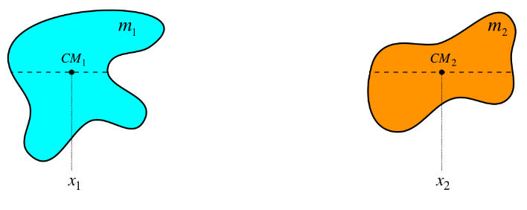
Center of Mass initialization
Convectional methods:
initialize the translation parameters of the transformation matrix by the center of mass of the input images
Also tested:
Doing same thing with the learning-based methods

Slide 30
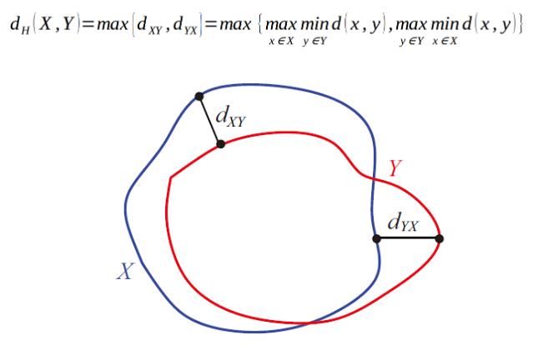
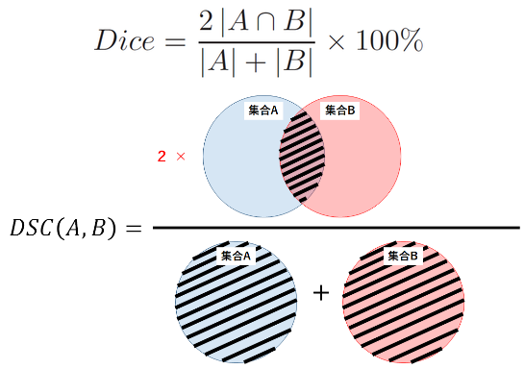




Measurement (Testing)
$$A$$
Register each subject test image $M$
To an atlas or MNI152 template $F$
Get a transformation matrix $A$
Apply $A$ to the segmentation of $M: S_{m}$
Measure similarity between $S_{m} and S_{F}$:
Dice
Hausdorff distance
$$F$$
$$M$$
Hausdorff distance

Slide 31
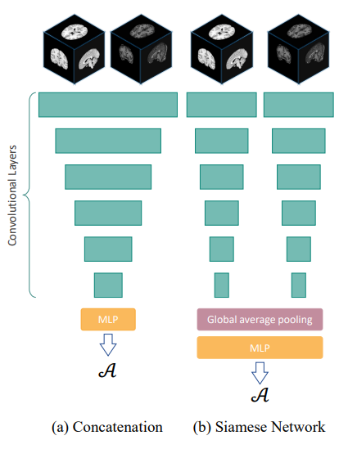
Baseline Methods
State of the art conventional methods (mutual information):
ANTs
Elastix
Learning based methods: affine subnetworks
Convnet-Affine
VTN-Affine
Used the same pyramid structure method
Same unsupervised and semi-supervised loss functions
VTN-Affine
ConvNet-Affine

Slide 32
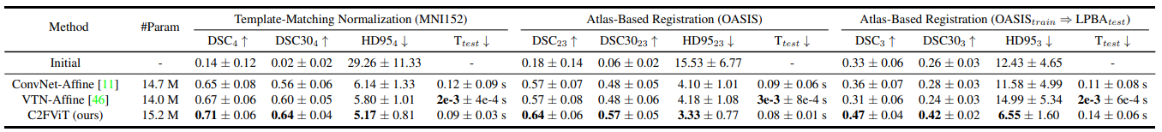














Results 1 (Without CoM initialization)
Compare to learning based methods
The C2FViT is better
Much better across datasets

Slide 33
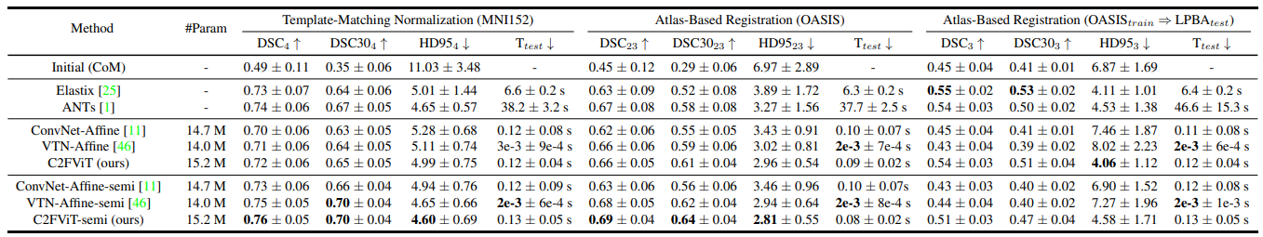















Results 2 (With CoM initialization)
Compare to learning based and conventional methods
Unsupervised vs semi-supervised (better)
The C2FViT is much better than the other learning-based methods
Better in some parameters then conventional with semi-supervision methods

Slide 34

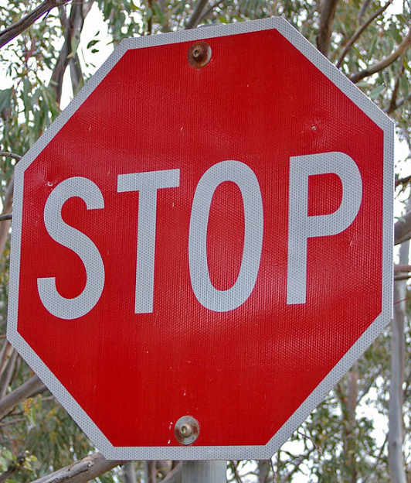
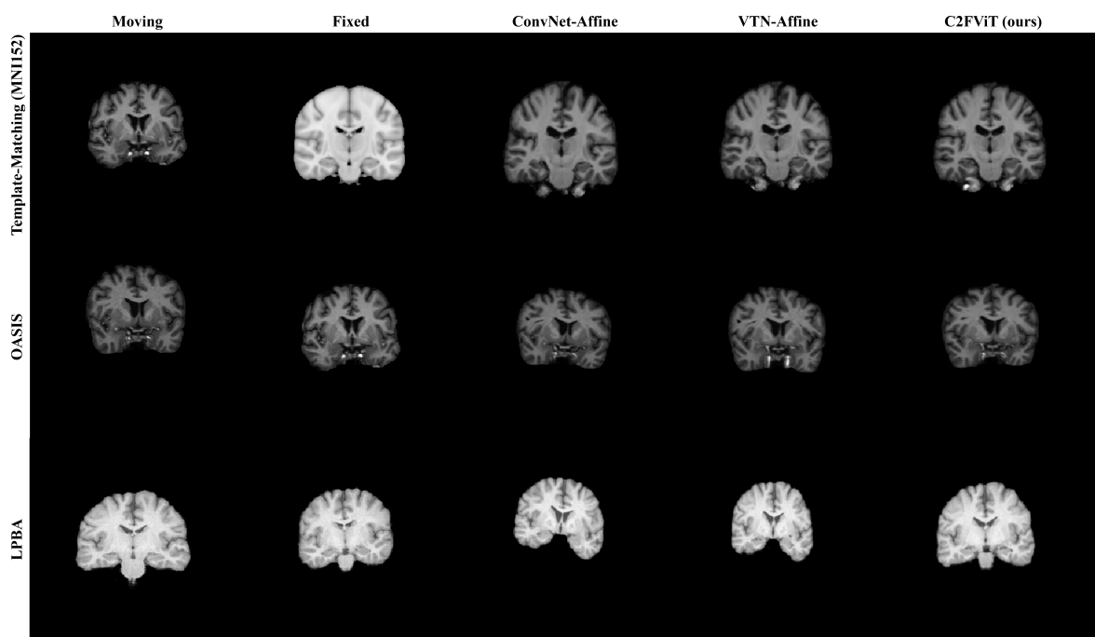


Results
Compare to other learning-based methods

Slide 35
Conclusions
A Coarse-to-Fine Vision Transformer for 3D affine medical image registration
Leverages the global connectivity of the self attention operator
Enhance locality using convolution layers
Achieves superior registration performance over the existing CNN-based methods, and conventional methods (in some cases)
Preserves the runtime of a learning-based method

Slide 36

Deformable Registration

Slide 37


Deformable registration
Necessary for matching soft tissue organs and for cross-patient comparisons ( tumor growth, heart beating etc.)
Much more difficult than affine registration
Notes:
מה זה דפורמבל – לשנות את התמונה בצורה לא לינראית , רוב הרקמות בגוף הם רכות ומקיימות שינויים כאלה בינן לבין עצמן.
מה המוטיבציה – לזהות את הרקמות במהלך התנועה שלהן כמו לב\ריאות , לזהות שינויים במהלך ניתוח , לזהות גידולים ועוד.

Slide 38


Why Deformable Registration Is A Difficult Problem ?
Large number of parameters to learn (can be ten of thousands)
Need to impose constraints
Solution is not unique – deepened on the complexity of the desired transformation model
Notes:
להבין מה זה ייל פוסט , נראלי זה אומר שאין מטריצת הטלה אחת שתעשה את הדבר הזה לא כמו הטלה אפינית.
בהטלה אפינית יש לך 12 פרמטרים – פה המספר יכול לגדול בצורה אדירה לאו הביא תמונה עם 2000 פרמטרים ללמוד

Slide 39

Notes:
החידוש העיקרי של המאמר הוא שבמקום ללמוד אופטימצזיה של כל פיקסל אנחנו לומדים פונקציה מלאה ככה ש הפעלתה על תמונה מוזזת תזיז אותה למקום הנכון – זה משפר מאוד את זמן הריצה של האלגוריתם במקום דקות עד שעות זה הופך פעולה מהירה של כמה שניות

Slide 40
Learn registration function instead of pairwise optimization
The biggest advantage of the VoxelMorph method is the fast-running time compare to other methods
The method can achieves such results because its doesn’t have to repeat the same exhausting optimization process for every new pair of images
The VoxelMorph learn generalized function for the entire dataset

Slide 41

The Method
Notes:
הרעיון הוא כזה : ניקח שתי תמונות 1 היא התמונה הקבועה F אליה נרצה להטיל את התמונה השניה M , נעביר את התמונה ברשת שלנו ונקבל את תטא – המטרה שאם נפעיל את תטא על M נקבל את F ולכן תהיה איזה פונקצית לוס שתעניש את הרשת אם היא לא מביאה תוצאות טובות

Slide 42


Set Up
*
The researchers took two images, $F$ as the fixed images and $M$ as the moving one.
Before the deformable process begins, they did affine transformation on the two images too place them in the same location. (to simplify the process)
Notes:
להבין מה זהvolume pair ולמה השיטה שלנו

Slide 43



The network
The Unet Architecture working well in medical data due to the connections between the encoder and the decoder (skip connections).
Notes:
הרשת היא רשת U כמו שכבר דיברו פה במאמר : זאת רשת Encoder – decoder בכל שלב מפעלים קרנל בגודל של 3*3*3 תוך כדי שימוש stride של 2 ככה התמונה קטנה פי שתיים תוך כדי הוספת מימד כל שלב מחובר לשלב המתאים לו כדי שלא נאבד לוקליות, בנוסף נעלה את הרשת חזרה לגודל המתאים כדי לקבל את תטא.

Slide 44



Optical Flow
Assuming the movement to be small, the image constraint at
Optical flow is the pattern of apparent motion of objects, surfaces, and edges in a visual scene.
Conventual methods use Taylor Series approximations to solve this problem. (Lucas-Kanade for example)
In recent years we use CNN to learn the optical flow of two images
This method is very effected by noise so we need to add regularization term
Notes:
להביא 2 תמונות להסביר שOpticl flow זה מעבר בין שתי תמונות ולהסביר שאחת הדרכים לעשות זאת היא באמצעות טור טיילור

Slide 45






Registration Field $(φ$)
Registration field is the mapping of coordinates from $M$ to $F$ (like optical flow)
$φ=id+u$ when $u$ is the displacement field between $F$ and $M$
the final goal is to achieve $φ$ s.t $F=M°φ$
To encourage smooth registration field the researchers used regularization parameter in the loss function.

Slide 46







Loss Functions (or- sorry about the math)
The loss function have two parts:
the similarity between $F$ and $M°φ$
regularization part for $φ$
In the study they use$ℒ_{sim}=MSE\left(F,M°φ\right)$
MSE works well when f and m have similar intensity distribution
They also try to use$ℒ_{sim}=−CC\left(F,M°φ\right)$
as the similarity loss
more robust to intensity.
Notes:
האמת שזה NCC ולא CC – הרעיון הוא לעשות קונבולציה בין שתי התמונות – אם שתי התמונות דומות תהיה קורולציה גבוהה ןלכן המינוס

Slide 47




Loss Functions (or- sorry about the math)
As we mention earlier, the biggest disadvantage of optical flow (or in our case $φ$) is it a very sensitive to noise.
To overcome this problem, we need to add regularization term for $𝓛_{us }$to obtain less noise sensitive (smooth) images.
The method encourages smoothness, by minimizing the gradients of $φ$ , are the neighbors of p (p$εΩ$) are close to p value.
$φ=id+u$ when u is the displacement field between f and m
Notes:
האמת שזה NCC ולא CC – הרעיון הוא לעשות קונבולציה בין שתי התמונות – אם שתי התמונות דומות תהיה קורולציה גבוהה ןלכן המינוס
מה זה U?

Slide 48




Segmentations Method
Notes:
כמו בשיטה הראשונה אבל כאן יש לנו גישה גם לסגמנטציה של התמונות 1 ככה גם האימון יכול להיות יותר ספציפי

Slide 49






Segmentations Loss Functions (or - sorry about the math 2)
In this method the researchers use Dice as part of the loss function * were each $S_{q}^{k} qε[F,M]$ is different segmentation part (color) from the $F$ or $M$
The Full loss function for the segmentations method is:
$$𝓛_{a} =𝓛_{sim}+λ𝓛_{smooth}+γ𝓛_{seg}$$
Where $λ$ and $γ$ are $\text{regularization}$ parameters.
$$S_{f}$$
$$S_{m}$$
Notes:
האמת שזה NCC ולא CC – הרעיון הוא לעשות קונבולציה בין שתי התמונות – אם שתי התמונות דומות תהיה קורולציה גבוהה ןלכן המינוס
מה זה U?

Slide 50


Experiment 1 - Atlas-Based Registration
In the following experiments the researchers took data set of $3731$ $MRI$ scans from eight datasets and split them to $3231$(train) 250 (validation) 250 (test) set
They include all anatomical structures that are at least $100$ voxels in volume for all test subjects, resulting in $30$ structures.
They quantify the volume overlap between structures using the Dice score
They compare the VoxelMorph results against $ANT$ sys and Nifty Reg, both are state of the art deformable methods

Slide 51














Experiment 1 - Results
$J_{φ}=jacobian$ : represent smoothness in the image
Notes:
לקחו מאגר של תמונות והשוו בין התוצאות שלנו לבין התוצאות של מערכות לבין האטלס –ground true
נשים לב שזאת לא השיטה הטובה ביותר בהכרח רק המהירה ביותר - לנסות להבין על j - ציון לחלקות התמונה
n mathematics, a diffeomorphism is an isomorphism of smooth manifolds. It is an invertible function that maps one differentiable manifold to another such that both the function and its inverse are differentiable.
להגיד שהשיטות השוו בין בלי כלום –affine וכלים חדשניים שונים – להגיד שant זה בלי למידה .
עוד משהו חשוב הוא שהמודל שלנו לא בהכרח קיבל את התוצאות הכי טובות להסביר שזה בגלל צורת הלמידה שלו – כללית ולא פרטית

Slide 52




Experiment 1 – continue
Effect of the training set size:
Effect of$λ$ size
Notes:
בדיקות צד- רואים אפקט נחמד שמספיק מאה תמונות אימון כדי לקבל תוצאות יחסית טובות
רואים את גודל הגמא הטוב עבור התמונה – יותר מידי גמא ונקבל תמונה ממש חלקה – פחות מידי גמא ונקבל תמונה ממש רועשת

Slide 53




Experiment 2 - Registration With Auxiliary Data
In this experiment the researchers use the same data set as experiment 1 and add segmentation to the modal training as we mention earlier.
They use $MSE$ with fixed 𝝀 =0.02 (obtain the best results) and different values of 𝛾.

Slide 54

Experiment 2
Subset train size: | 1 | 15 | 30(all)
Notes:
בדקנו פה את השפעת רכיב הרגולזציה גמא על 3 מצבים – הראשון הוא שאימנו רק על רכיב סגמנטציה אחד השני הוא שאמינו על 15 רכיבי סגמנטציה והשלישי הוא שאימנו על כל רכיבי הקשירות – נשים לב שיש פה אובר פיט לרכיב הקשירות שאימנו עליו ככל שנעלה את הגמא

Slide 55

Conclusion – article 2
Learn registration function instead of pairwise optimization
Run significantly faster then the compered to the state-of-the-art methods
Don’t need a big data set to obtain good results

Slide 56
Summary
We talked about affine registration
We presented deep learning method to the affine registration that use transformers to obtain better results then the state-of-the-art methods.
We talked about deformable registration
We presented deep learning method to the deformable registration how use CNN and global learning function to obtain faster run time then the state-of-the-art methods.

